Slide 1
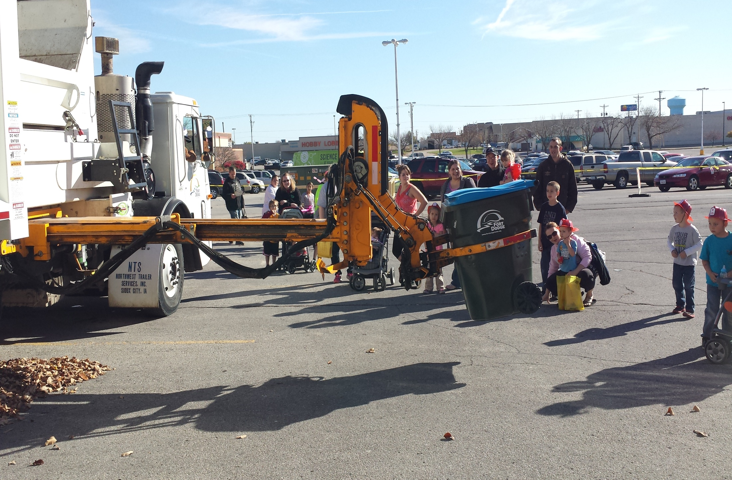
FY 2016 Sanitation Budget Revisit

Slide 2
expenditure snapshot
ACCOUNT DESCRIPTION | ACTUAL 2014 | ACTUAL OCT 2014 | BUDGET 15 | 2016 REQUEST
SOLID WASTE REVENUES | 1,531,196 | 486,325 | 1,447,900 | 1,454,868
SOLID WASTE EXPENSES | 2,444,965 | 429,607 | 1,093,814 | 1,512,160
PERSONNEL SERVICES | 354,976 | 130,858 | 365,700 | 385,460
CONTRACTUAL SUPPLIES & SVCS | 337,555 | 163,059 | 328,720 | 428,200
COMMODITIES | 101,750 | 38,272 | 47,000 | 92,100
CAPITAL OUTLAY | 1,341,285 |  |  | 250,000
FICA AND IPERS | 57,434 | 17,416 | 62,000 | 65,000
HEALTH AND LIFE INSURANCE | 133,318 | 17,099 | 146,300 | 140,300
WORKERS COMP INSURANCE | 21,696 | 30,909 | 25,000 | 31,900
UNEMPLOYMENT | 4,827 | 0 | 2,500 | 2,500
GENERAL GOV ALLOCATABLE COST | 9,124 | 0 | 11,661 | 12,000
TRANSFERS, INTERNAL SRV, NON PRGM | 83,000 | 31,994 | 104,933 | 104,700
For City-wide clean-up day
Need to add $20,000 to FY 2015 and $20,000 to FY 2016

Slide 3
Fund balance snapshot
Resources:
Projected FY15 Fund Balance | 722,965
Projected FY15 revenues | 1,454,868
Total Resources | 2,197,833
FY 2016 Expenses | 1,512,160
Projected FY16 Fund Balance | 665,673
For City-wide clean-up day
Dropped Projected FY 2015 Fund Balance by $20,000
added $20,000 to FY 2016
Expenses
Dropped FY 2016 Fund Balance by $40,000

